Slide 1
Responsive E-Commerce Website
Name - Manas Mamgain Mentor - Mr. Ramesh
Singh Rawat
Roll No.-2019562 Designation -Assistant Professor
Section-CE

Slide 2
Introduction
In today's rapidly evolving digital age, the necessity for a robust online presence through dedicated websites has become more critical than ever.
A well-designed website serves as a powerful tool for companies across various industries to establish their brand, reach a global audience, and provide 24/7 accessibility to their products and services.
Through innovative technology, a user-centric design, and a commitment to security, we aim to create a seamless and enjoyable shopping journey.

Slide 3
Whether you're a tech-savvy or a busy professional, our e-commerce website is designed to cater to your unique needs, offering everything from personalized recommendations to efficient order fulfillment.
In today's rapidly evolving digital age, the necessity for a robust online presence through dedicated websites has become more critical than ever.
Moreover, an e-commerce website enables businesses to showcase their entire product range, offer personalized shopping experiences, and implement targeted marketing strategies.
It serves as a powerful tool for gathering customer insights, analyzing purchasing behavior, and refining marketing tactics.

Slide 4
Methodology
Step 1: Setting Up the Project Structure
We began by setting up a clear and organized project structure. This included creating directories for different modules such as product management, cart functionality, user interface components, and utility functions. Each module is responsible for a specific aspect of the website, ensuring maintainability and scalability.
Step 2: Implementing Product Management
One of the key components of our e-commerce platform is the management of product data. We developed scripts to handle the display of products on the home page and manage product quantities. For example, in 'homeProductCards.js', we implemented functions to dynamically generate product cards based on the available stock and user interactions.

Slide 5
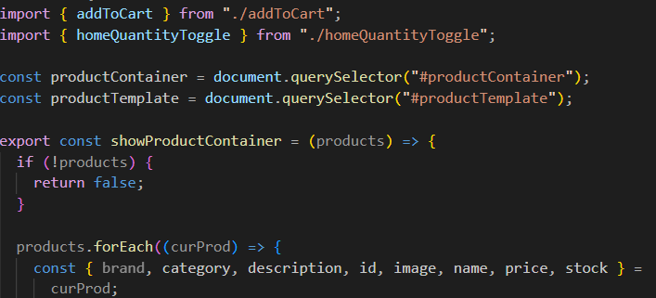
In this snippet of code we handle of the products on the home page and manage product quantities.

Slide 6
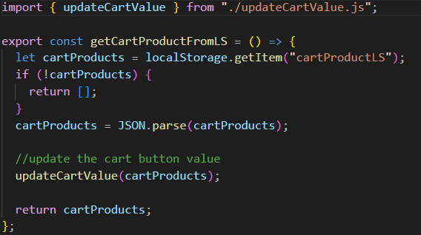
Step 3: Cart Management
Managing the shopping cart is crucial for any e-commerce website. We created functions to handle adding products to the cart, updating quantities, and reflecting these changes in the local storage. The ‘getCartProductFromLS.js’ module retrieves cart data from local storage, ensuring the cart is always up-to-date.
This snippet of code describes how to handle quantities of the product in the cart.

Slide 7
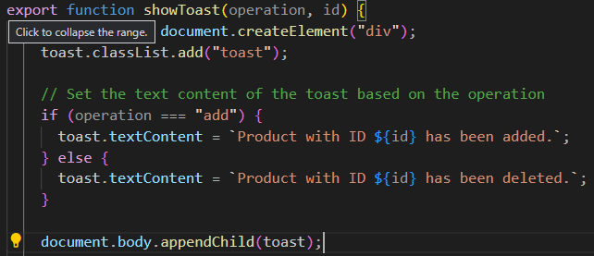
Step 4: User Interaction
To enhance user experience, we implemented real-time feedback mechanisms such as toasts to notify users when they add products to the cart. The showToast.js module is responsible for creating and displaying these notifications.
This snippet of code shows how pop up notification works when user do any change to their cart in the website.

Slide 8
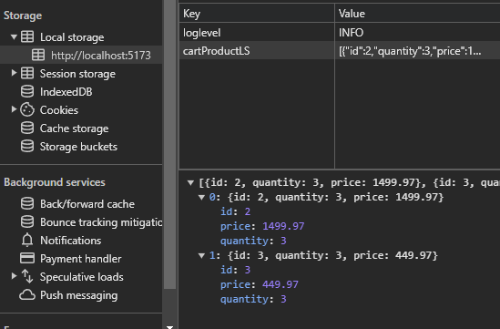
Step 6: Ensuring Consistency and Data Integrity
To ensure that the cart data is consistent and always up-to-date, we frequently retrieve and update the local storage using utility functions. This ensures that users have a smooth and seamless shopping experience, with accurate product quantities and prices reflected at all times.
A local storage is maintained in the user browser to keep the track of the user products.

Slide 9

Result:-

Slide 10
A working website with a enhanced frontend where user can jump to multiple pages and choose a product and can add it to their cart additionally they update the cart after going to payment page.

Slide 11
Future Work:
Enhanced User Authentication and Personalization
User Accounts: Implement a comprehensive user authentication system that allows users to create accounts, log in, and maintain personalized profiles.
Checkout Experience
Payment Gateway Integration: Integrate multiple payment gateways to provide users with a variety of payment options, enhancing the checkout experience.
Security Enhancements
Data Encryption: Implement advanced encryption techniques to protect user data and ensure secure transactions.

